Slide 1
EECS 498 System Design of a Search Engine
Winter 2026
Lecture 1: Introduction
Nicole Hamilton
https://web.eecs.umich.edu/~nham/
nham@umich.edu

Slide 2
agenda
Course staff
Course organization
Learning objectives
System design
The project
Basic parts of a search engine
Planning your engine
Teamwork
The world around us
Beautiful software
Problem solving

Slide 3
agenda
Course staff
Course organization
Learning objectives
System design
The project
Basic parts of a search engine
Planning your engine
Teamwork
The world around us
Beautiful software
Problem solving

Slide 4
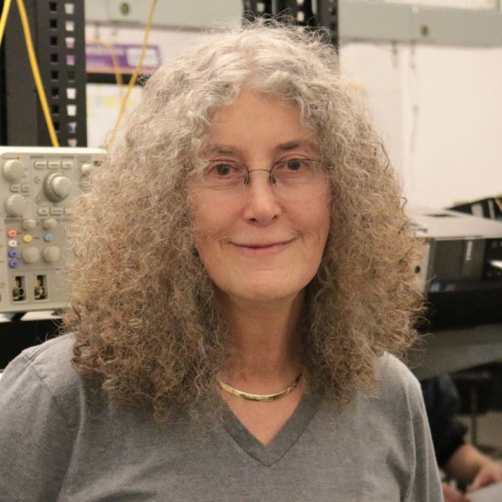
Nicole Hamilton
Education
BS & MS EE, Stanford, 1973.
MBA, Boston University, 1987.
Background
Started my career doing hardware design at IBM but quickly moved into software.
Spent most of my career as an entrepreneur selling a C shell I wrote.
When the dot-com collapse hit, I went to Microsoft, where I worked on the first release of Bing.
Thought I was retired when I fell into a new career teaching.
nham@umich.edu
https://web.eecs.umich.edu/~nham/
Office: Beyster 4820
C: 425-765-9574
Office hours:
TTh 3:00 pm to 4:00 pm

Slide 5
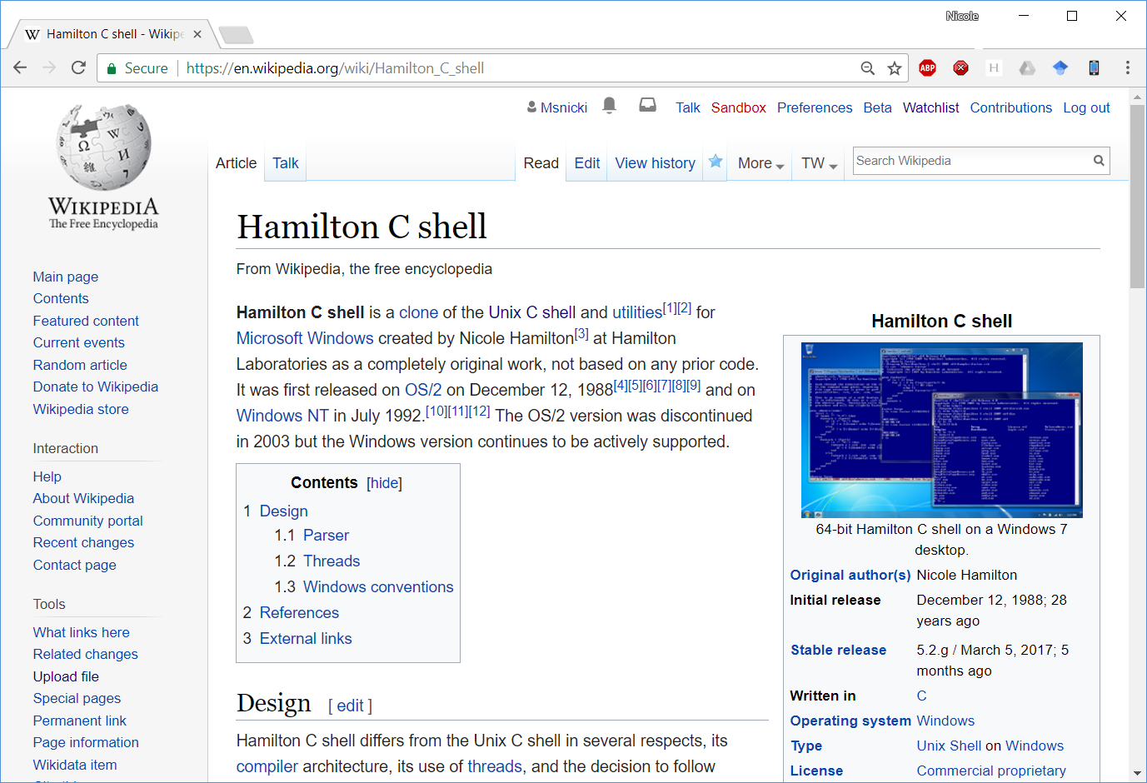

Slide 6
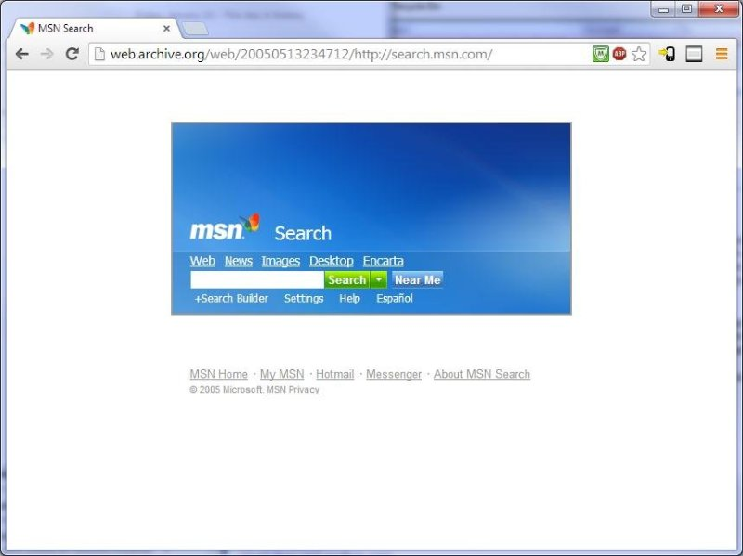
MSN Search in early 2005.

Slide 7
Joined the team in July 2003 as the ninth member.
The ranker was the last major piece no one had taken.
Wrote the ranker and the query language for the first release in January 2005.
Almost 30 KLOC in C++.

Slide 8
This is the sixth time I’m teaching this class.
I'm still working to improve it.

Slide 9

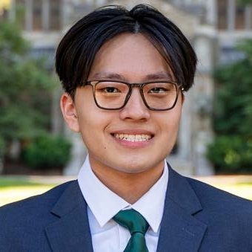
staff
Christopher Davis
chcdavis@umich.edu
Rickey Dong
rickeyd@umich.edu

Slide 10
agenda
Course staff
Course organization
Learning objectives
System design
The project
Basic parts of a search engine
Planning your engine
Teamwork
The world around us
Beautiful software
Problem solving

Slide 11
Course organization
You don’t need to know anything more than 281.
I will teach you everything else you need to know.
First half will focus on operating system topics needed to build a search engine.
Second half will focus building the engine.
You’ll have homework every week to help you learn the material. You’ll do most of it in groups.
I’m more interested in your completing an assignments than the deadline. If you need an extension, talk to me.

Slide 12
This semester
The schedule and almost all the assignments for the entire semester are posted on Canvas.
Most of the homework assignments are coding exercises you’ll submit to the autograder.
On group assignments, you are free to break up the work any way you like.
Your first assignments are this weekend.

Slide 13
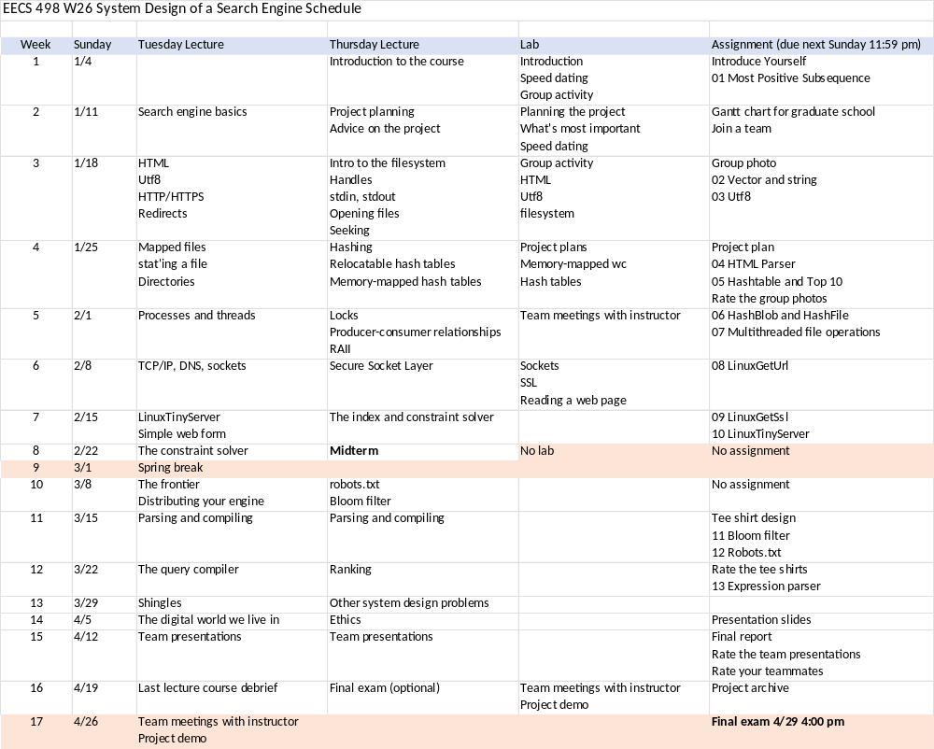

Slide 14
Grading
Group project
Group performance 25%
Individual contribution 25%
Homework
Group 10%
Individual 10%
Midterm 15%
Optional final 15%
The midterm is mandatory.
If you skip the final, I’ll use your midterm score.
Some of the grading will be done by surveys.

Slide 15
Past curves
Here was the grade distribution last time.
Having realized you have easier alternatives, I’ve eased my grading.

Slide 16
Your team grade on the project
Slightly competitive, based on ranking your engine’s functionality, performance, e.g., time and size to crawl, create or search a multi-terabyte index, its features and result quality against the engines created by the other teams.

Slide 17
Your individual grade on the project
Your individual grade on the project will be based on:
The number of lines of code you contribute relative to others on your team and in the class.
A survey of your teammates asking them to rate your contribution and performance.

Slide 18
Your first homework
This weekend:
Write a short introduction of yourself with a recent picture.
A coding problem, MostPositivedSubsequence( ). You’ll submit your code to the autograder and upload a screenshot of your debugger.
This is the only coding homework you’ll have to do alone.

Slide 19
HW1 MostPositiveSubsequence( )
Write a C++ function that can scan a sequence of N integers in an array A, returning the sum and the left and right indices of the most positive subsequence.
For example, for the sequence
{ -1, 3, 5, 6, -2, -4, 1, 7, -15, 12, 7, -5 }
0 1 2 3 4 5 6 7 8 9 10 11
the best sum = 20, left = 1, right = 10.

Slide 20
HW1 MostPositiveSubsequence( )
Due Sunday, January 12, 2025.
Write and submit two C++ files to the autograder.
  MostPositiveSubsequence.cpp, containing your implementation of the MostPositiveSubSequence( ) function.
  BestSubsequence.cpp, containing a simple main( ) routine that takes a sequence on the command line an argv and reports the results.
You must also demonstrate that you can build and debug it with a graphical debugger by uploading a screenshot showing you stepping through your code.

Slide 21
General rules for homework
Unless otherwise specified:
You must solve it on your own or as a registered group.
Do not use AI to do your work for you.
You are to make good choices anywhere you find the spec ambiguous and you will be judged on them.
You may not discuss it with others or use the internet or other resources to help.

Slide 22
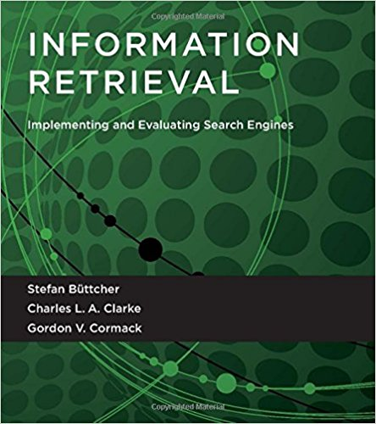
Textbooks
Information Retrieval: Implementing and Evaluating Search Engines
Reprint edition (February 12, 2016)
Stefan Büttcher, Charles L.A. Clarke, Gordon V. Cormack
The MIT Press
ISBN 978-0262528870
There’s a PDF posted on Canvas.
Read the first 6 chapters.

Slide 23
All the work must be your own
Submitting work that’s not your own or attempting to deceive me will be reported for academic misconduct.
I’m good at spotting misconduct and very good at reporting it.
I do not give warnings. I report everything.

Slide 24
Where you’ll find stuff
Canvas for announcements, lecture recordings, files, individual and group homework assignments and grades.
The autograder to test code submissions.
EdStem for questions and discussion.

Slide 25
agenda
Course staffCourse organization
Learning objectives
System design
The project
Basic parts of a search engine
Planning your engine
Teamwork
The world around us
Beautiful software
Problem solving

Slide 26
Learning objectives
Ability to work on a team to design a large software project.
Learn how a search engine works.
Learn how to use low-level OS facilities.
Ability to create elegant, reliable code in C++.
How to distribute a system across multiple machines.
An appreciation of software as art.
The ability to communicate your results.
Exposure to other topics related to the practice of engineering.

Slide 27
Interwoven themes
What is system design?
What is a beautiful design?
How do you tackle a large project?
How do you work as a team?
How does a search engine work?
How do you use the operating system?

Slide 28
agenda
Course staff
Course organization
Learning objectives
System design
The project
Basic parts of a search engine
Planning your engine
Teamwork
The world around us
Beautiful software
Problem solving

Slide 29
systems
What makes something a system?
What’s special about designing systems?

Slide 30
system design projects
There’s an important domain-specific part: You need to learn something new about an interesting problem you’ve never seen before.
You need to invent a solution with lots of moving parts.
They’re usually “close to the metal”.
They're usually team efforts because they're too big to do any other way.
You get to build your part from scratch and it feels good.
A search engine hits on every bit of what a system design project is to me.
I also intend for it to relatable to family and friends and recruiters.
I want you to get jobs.

Slide 31
agenda
Course staff
Course organization
Learning objectives
System design
The project
Basic parts of a search engine
Planning your engine
Teamwork
The world around us
Beautiful software
Problem solving

Slide 32
the project
You are to self-select into teams of 6 to design and build an end-to-end search engine completely from scratch in C++, assigning your own roles.

Slide 33
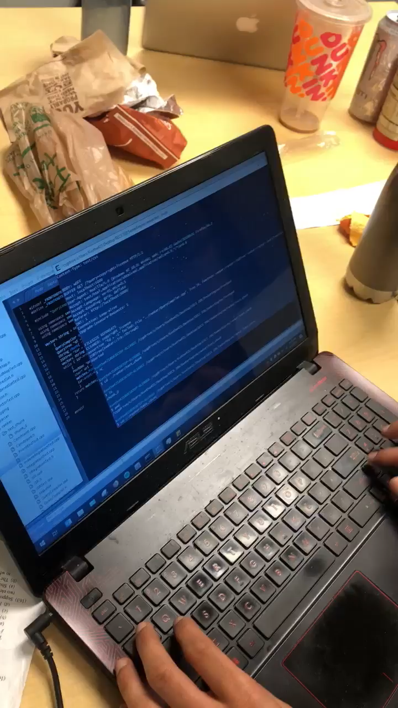
It’s supposed to be fun.
The Seekers captured the moment in W19 when their engine finally worked.
It was 5:00 am.

Slide 34
past engines in LOC
 | Project total |  |  |  |  |  | Individual
 | w18 | w19 | f19 | w21 | w25 |  | w18 | w19 | f19 | w21 | w25
High | 14,271 | 26,887 | 19,264 | 20,523 | 48,027 |  | 4,096 | 8,646 | 7,826 | 8,127 | 13,506
Median | 5,300 | 13,000 | 11,973 | 11,647 | 16,581 |  | 1,006 | 1,750 | 1,572 | 1,800 | 1,843
Low | 4,170 | 9,414 | 4,575 | 5,887 | 6,132 |  | 0 | 444 | 120 | 200 | 400

Slide 35
past index sizes in documents
 | w18 | w19 | f19 | w21 | w25
High | 13.4M | 150M | 586M | 536M | 100M
Median | 8,000 | 4.65M | 397M | 84M | 45M
Low | 4,816 | 1.9M | 207M | 3M | 10M

Slide 36
agenda
Course staff
Course organization
Learning objectives
System design
The project
Basic parts of a search engine
Planning your engine
Teamwork
The world around us
Beautiful software
Problem solving

Slide 37
basic parts of a search engine
These are the basic pieces you will need.
HTML parser.
Crawler.
Index.
Constraint solver.
Query compiler.
Ranker.
Front end.

Slide 38
the index build side
Seed list
Crawler
HTML parser
Index build
Index files

Slide 39
the query serve side
Queries
Front end
Query compiler
Constraint solver
Ranker
Results
Index server
Index files

Slide 40
agenda
Course staff
Course organization
Learning objectives
System design
The project
Basic parts of a search engine
Planning your engine
Teamwork
The world around us
Beautiful software
Problem solving

Slide 41
your search engine
You may deliver your engine on any platform but everyone always chooses Linux.
I will arrange $50 Google Cloud accounts for all of you.
Almost all of your work will be in C++ and all of it must be yours.
I’ve posted my stylesheet but no one ever follow it. (Your loss.)
I care less about test cases than I do about getting things working.
You are discouraged from using STL unless you write your own versions.
You will meet with me periodically as a team to discuss your plans and progress.
You will give a short presentation of your results to the class.
You will have a final review, demo, submit a paper and an archive of your code.

Slide 42
levels of functionality
0. Create a plan.
Parse text files into a hash table.
Build a crawler.
Build a reverse word index.
Create a user interface.
Build a constraint solver and query parser.
Build a ranker.
Advanced functionality, e.g., distributed processing.

Slide 43
agenda
Course staff
Course organization
Learning objectives
System design
The project
Basic parts of a search engine
Planning your engine
Teamwork
The world around us
Beautiful software
Problem solving

Slide 44
What are the most important determinants of all your outcomes in life?
I suggest it’s all the other people in your life.
Sometimes, you get to choose.

Slide 45
observations
On the best-performing teams:
They like each other.
They buy into the rules and set out to win at them.
Their plans are filled with a lot of brain-storming about the problems they need to solve and how they’ll do it.
There’s a lot of brain-storming in their execution as well.
They come to my office frequently.

Slide 46
observations
On teams having difficulties:
Their plans are often thin on detail, treating much of the design as TBD once we got to the appropriate lecture.
They check off some “all of the above” boxes, e.g., “all of level 7”, without much analysis of what that would entail.
There are questions about who is in charge. Decisions don’t get made. No one is available to meet at the same time.
They don’t do a lot of brainstorming and they don’t resolve technical questions with technical arguments.
Interfaces between the components and what each component does are unclear.
They complain about the rules.

Slide 47
observations
What makes for a great teammate:
They step up and get stuff done.
It’s less about what they know and more about what they’re willing to do.
They have lots of ideas but they don’t insist on their own.
They respect boundaries.
They’re available and supportive.

Slide 48
Your first group activity is to form a group and submit a group photo.
We’ll do “speed dating” breakouts in the labs this week to help you get to know others in the class.
You are welcome to invite friends into the class to round out your group. Talk to me.

Slide 49
group photo
You are to form groups of 6, choose a name for your group and submit a photo of yourselves.
You must all appear in the photo. Faces have to be clearly visible and easily recognized.
Each person must be named in the photo.
Your group name must appear in the photo.
You may not spend any money on this.
You can edit the image but, please, no pasting your faces on other people’s heads or bodies.
You may not steal copyrighted artwork.
You may use public domain images.

Slide 50
This assignment is slightly competitive based on creativity and execution.
Your grades will be determined by a vote.
Please submit only one copy for the entire team.

Slide 51
Here were some past submissions.

Slide 52


Slide 53
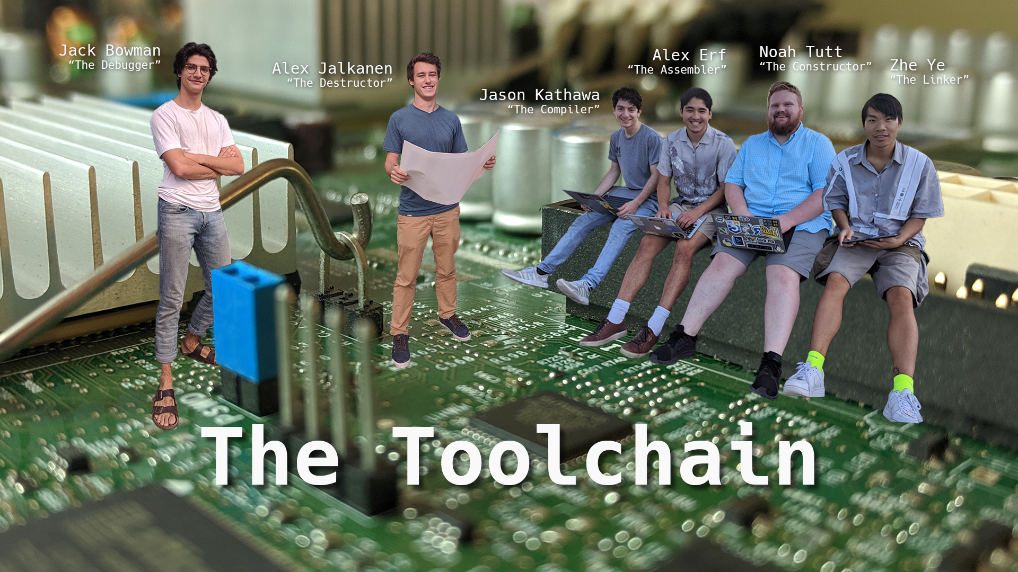

Slide 54
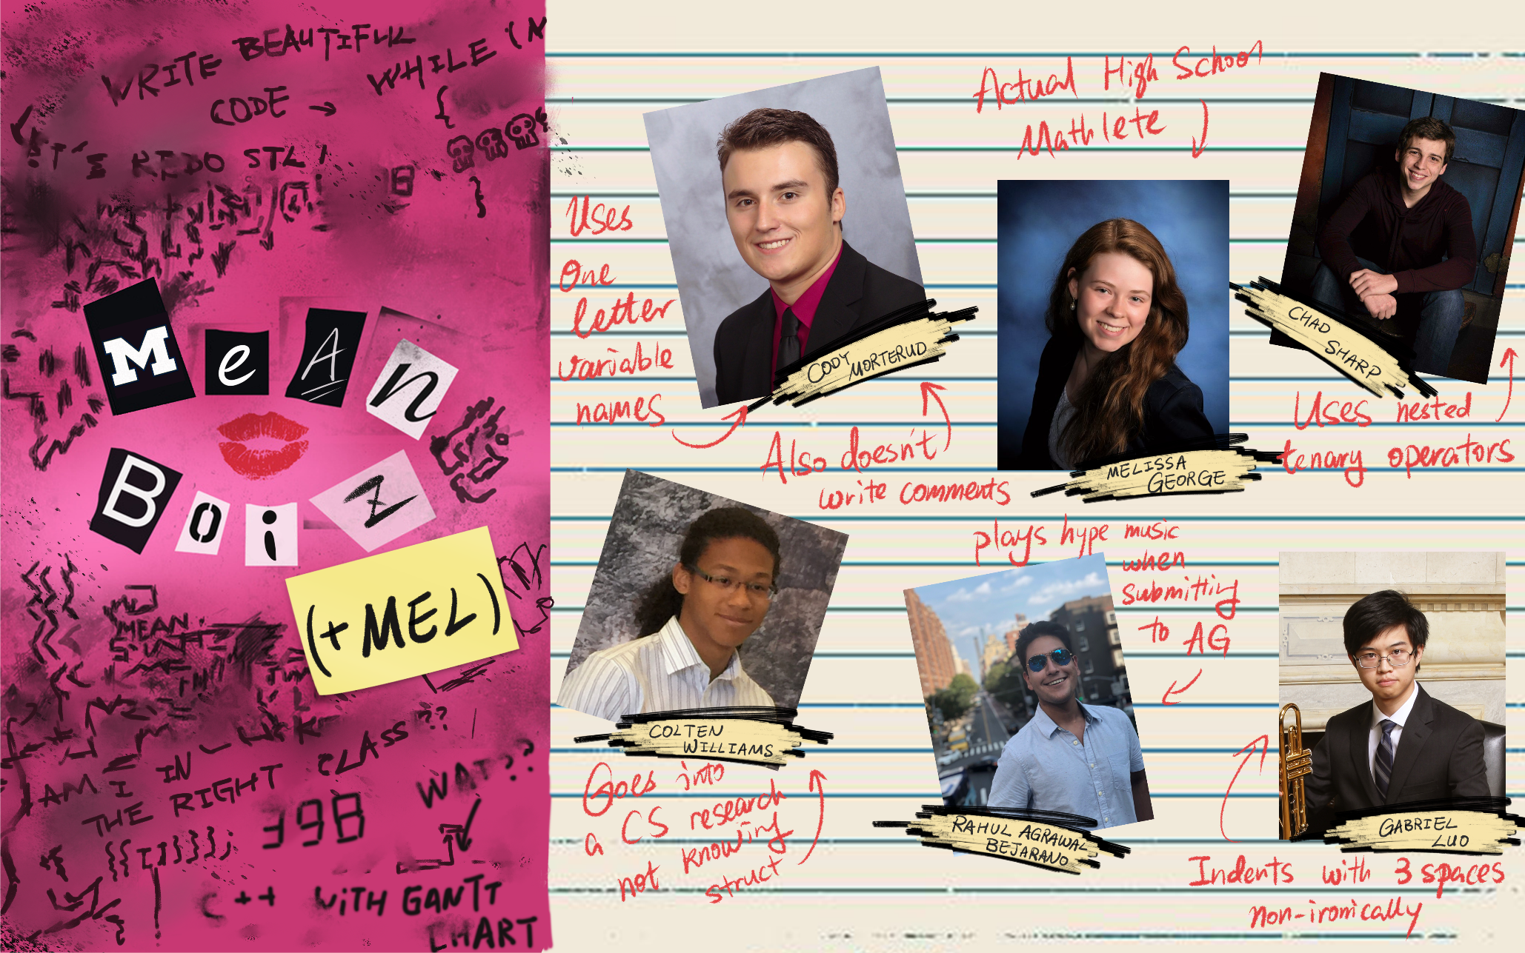

Slide 55
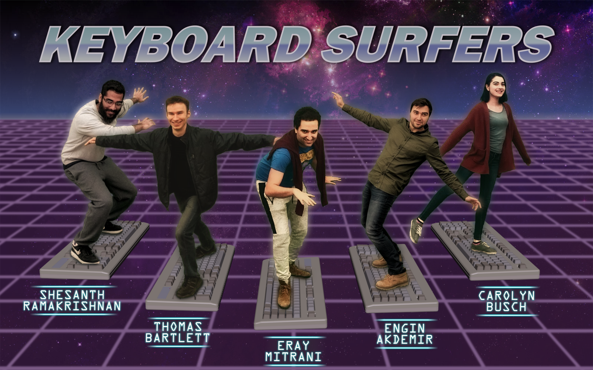

Slide 56
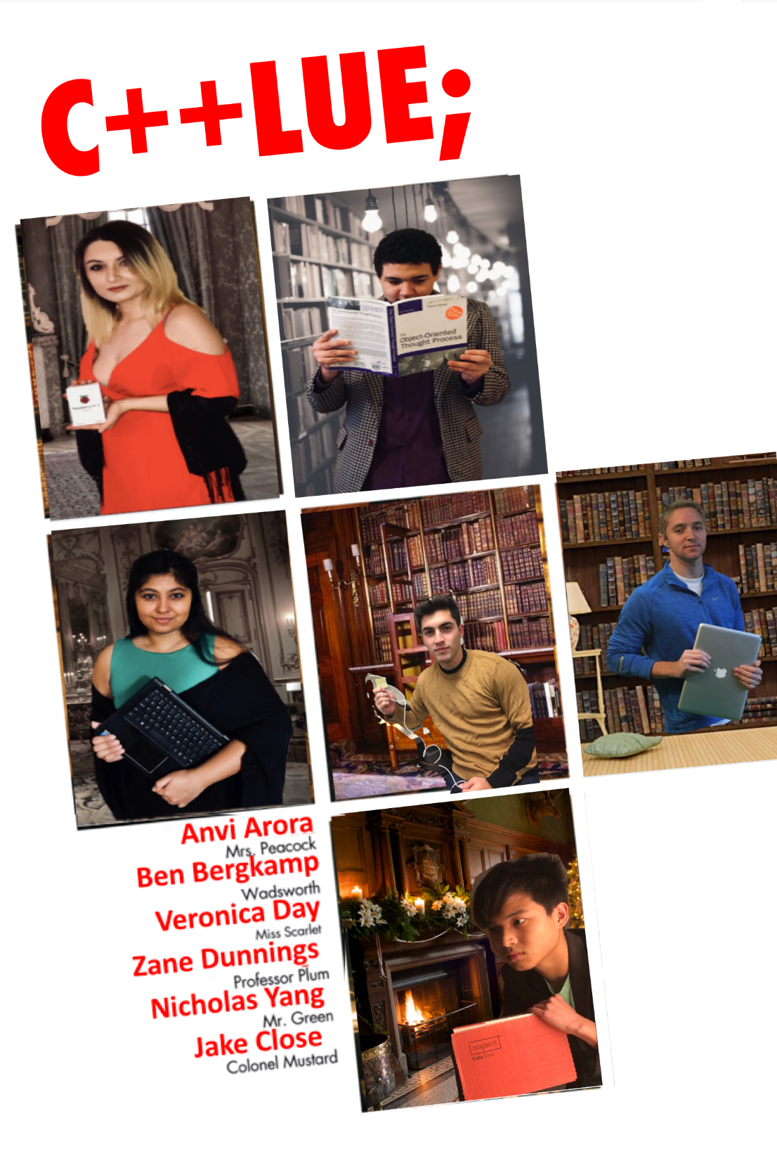

Slide 57
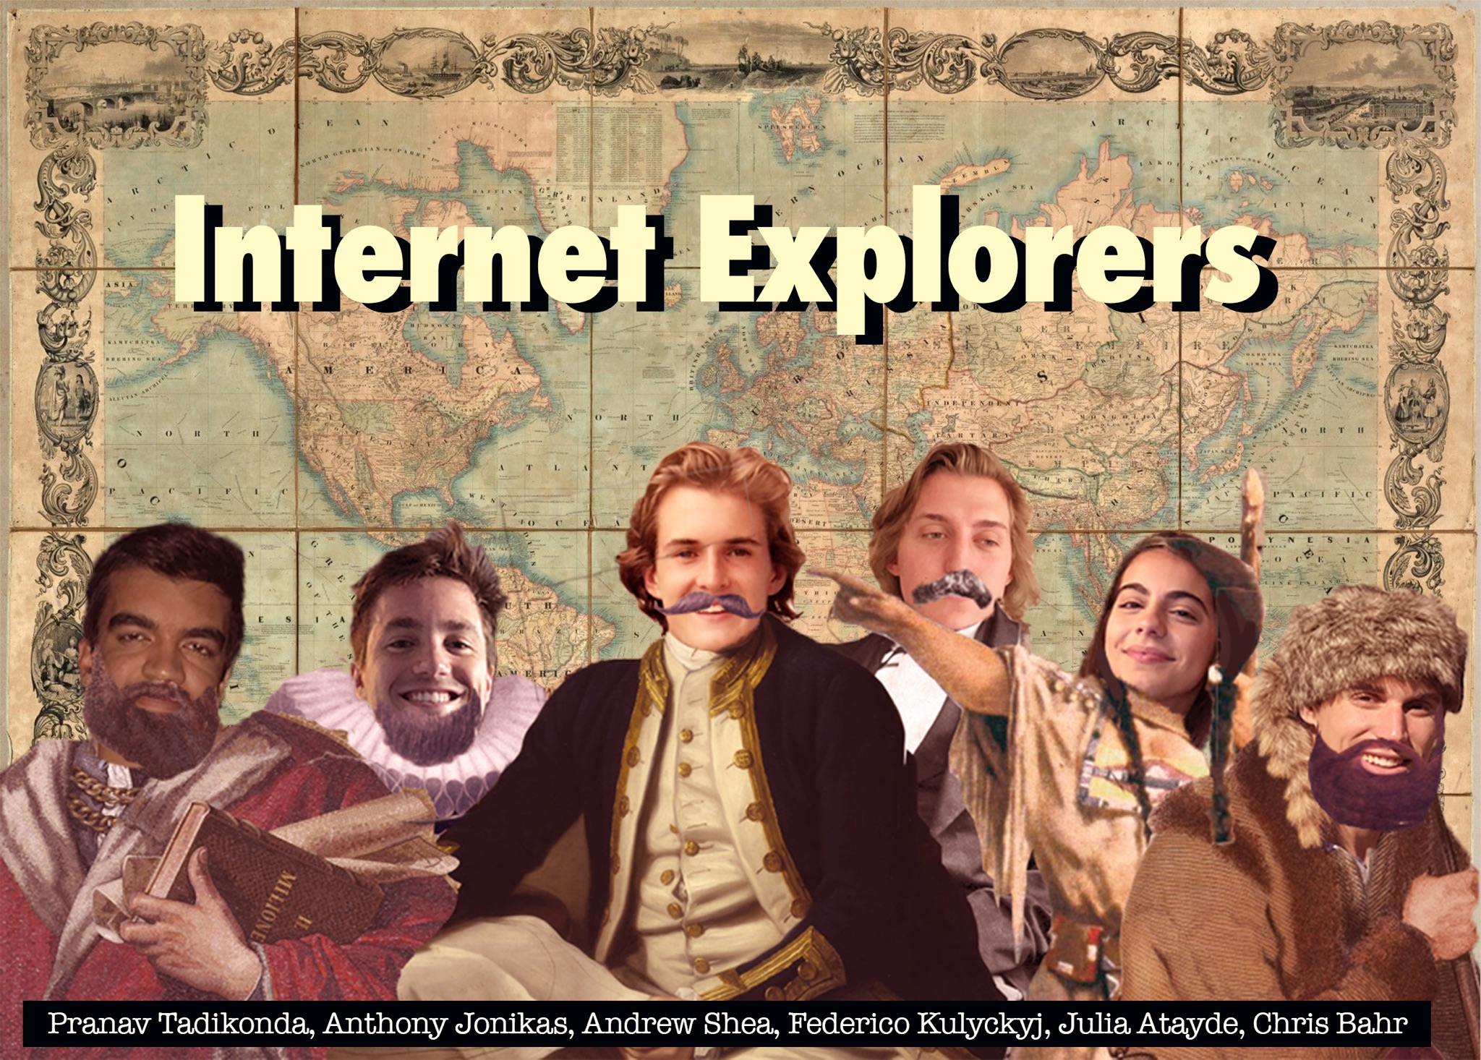

Slide 58
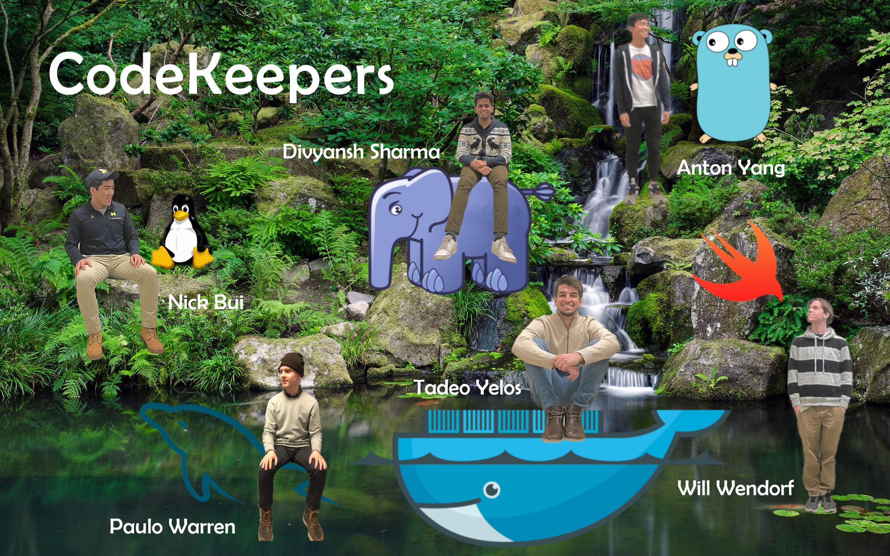

Slide 59


Slide 60


Slide 61
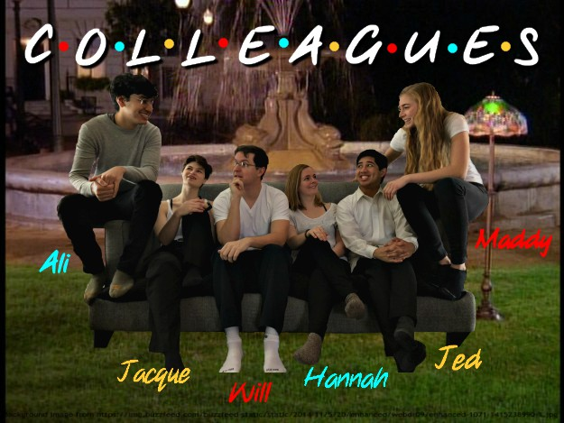

Slide 62
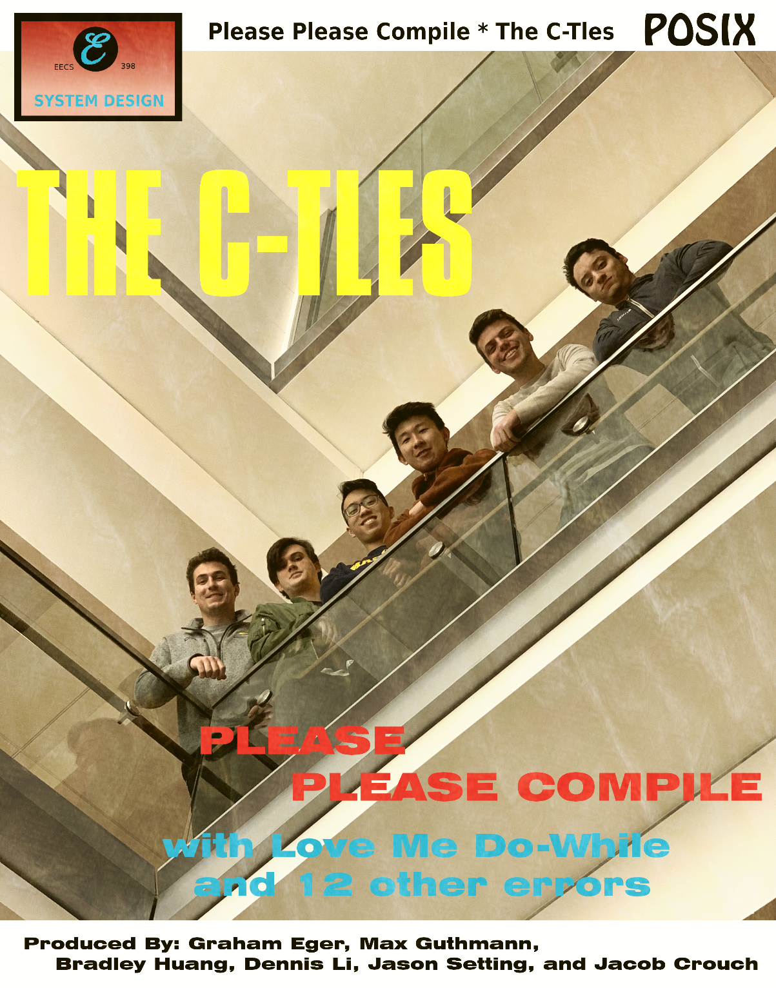

Slide 63


Slide 64
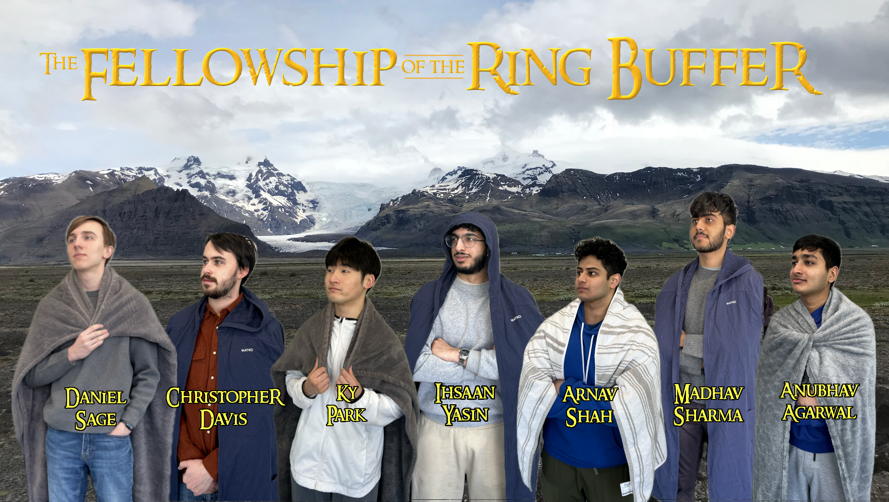

Slide 65
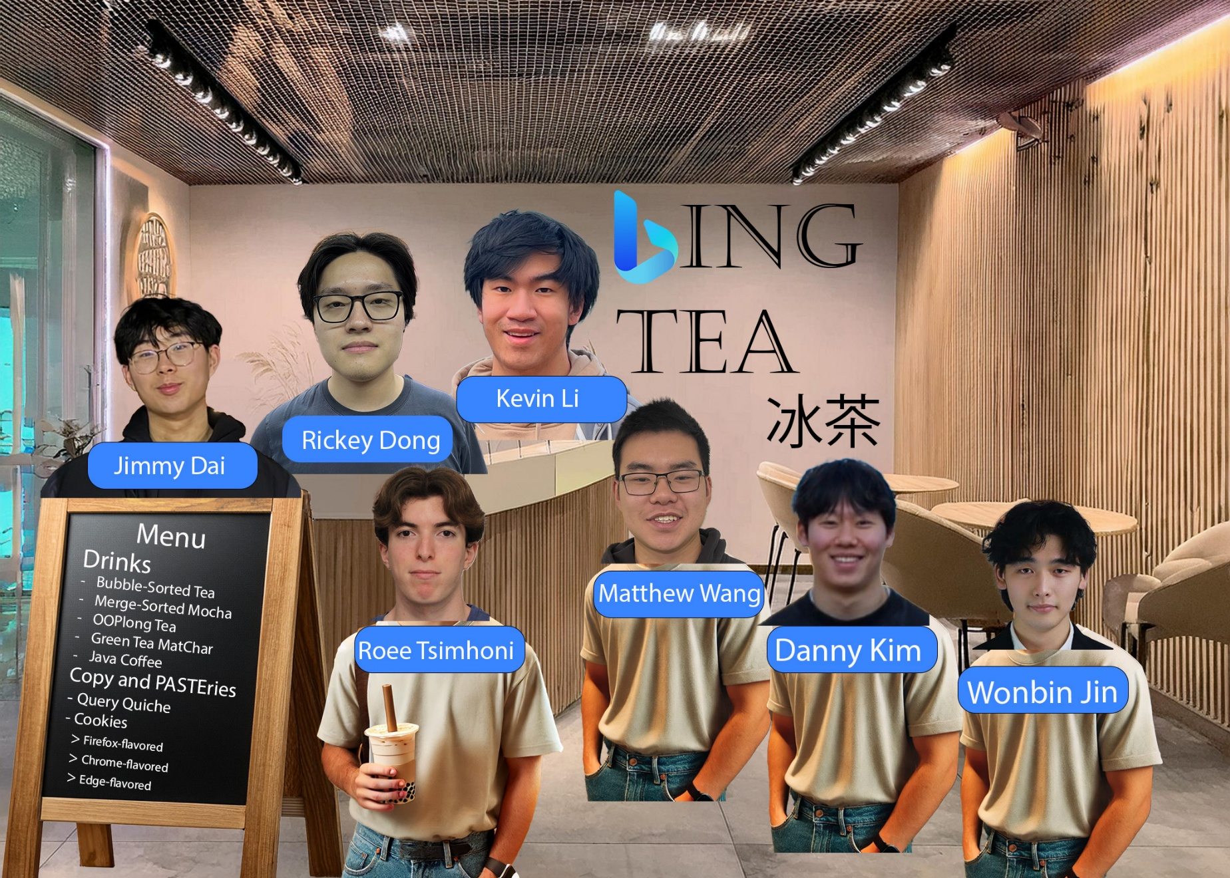

Slide 66
my usual experience
A team’s performance on the simple task of submitting a creative photo of themselves is often predictive of how they’ll do on everything else.
Please don’t do something lame.

Slide 67
agenda
Course staff
Course organization
Learning objectives
System design
The project
Basic parts of a search engine
Planning your engine
Teamwork
The world around us
Beautiful software
Problem solving

Slide 68
if you are 20 in 2026
But none of these statements are true for your parents.
TV has never had snow.
You could listen to any song you want anytime you want.
Phones have always had apps.
Cameras have never used film.
You can buy anything online.
Everyone has always had computers.
Music has never has hiss.

Slide 69
if you are 20 in 2026
DirecTV begins direct digital satellite broadcasting June 17, 1994. (31 years)
HD becomes available in the US in 1998. (28 years)
FCC mandates that all TV in the US is HD on June 12, 2009. (16 years)
TV has never had snow.
You could listen to any song you want anytime you want.
Phones have always had apps.
You can buy anything online.
Everyone has always had computers.
Music has never has hiss.
There was never a time before credit cards.

Slide 70
if you are 20 in 2026
iPod released October 23, 2001. (24 years)
TV has never had snow.
You could listen to any song you want anytime you want.
Phones have always had apps.
Cameras have never used film.
You can buy anything online.
Everyone has always had computers.
Music has never has hiss.

Slide 71
if you are 20 in 2026
iPhone released June 29, 2007. (19 years)
TV has never had snow.
You could listen to any song you want anytime you want.
Phones have always had apps.
Cameras have never used film.
You can buy anything online.
Everyone has always had computers.
Music has never has hiss.

Slide 72
if you are 20 in 2026
Consumer digital cameras become available in the 1990s and overtake film in 2003. (23 years)
TV has never had snow.
You could listen to any song you want anytime you want.
Phones have always had apps.
Cameras have never used film.
You can buy anything online.
Everyone has always had computers.
Music has never has hiss.

Slide 73
if you are 20 in 2026
eBay goes live September 3, 1995. (30 years)
Amazon goes live July 16, 1995. (30 years)
TV has never had snow.
You could listen to any song you want anytime you want.
Phones have always had apps.
Cameras have never used film.
You can buy anything online.
Everyone has always had computers.
Music has never has hiss.

Slide 74
if you are 20 in 2026
Apple II goes on sale June 10, 1977. (48 years)
IBM PC released August 12, 1981. (44 years)
TV has never had snow.
You could listen to any song you want anytime you want.
Phones have always had apps.
Cameras have never used film.
You can buy anything online.
Everyone has always had computers.
Music has never has hiss.

Slide 75
if you are 20 in 2026
Compact discs introduced in Japan in November 1981. (44 years)
TV has never had snow.
You could listen to any song you want anytime you want.
Phones have always had apps.
Cameras have never used film.
You can buy anything online.
Everyone has always had computers.
Music has never had hiss.

Slide 76
what made this possible
Three key technologies made this possible.
Positional numbers
Digital circuits
Microelectronics

Slide 77
what made this possible
Positional number systems, where each position is a power of the base, were invented by the Babylonians, making arithmetic simple.
(Consider the alternative of doing addition in Roman numerals.)
Positional numbers
Digital circuits
Microelectronics

Slide 78
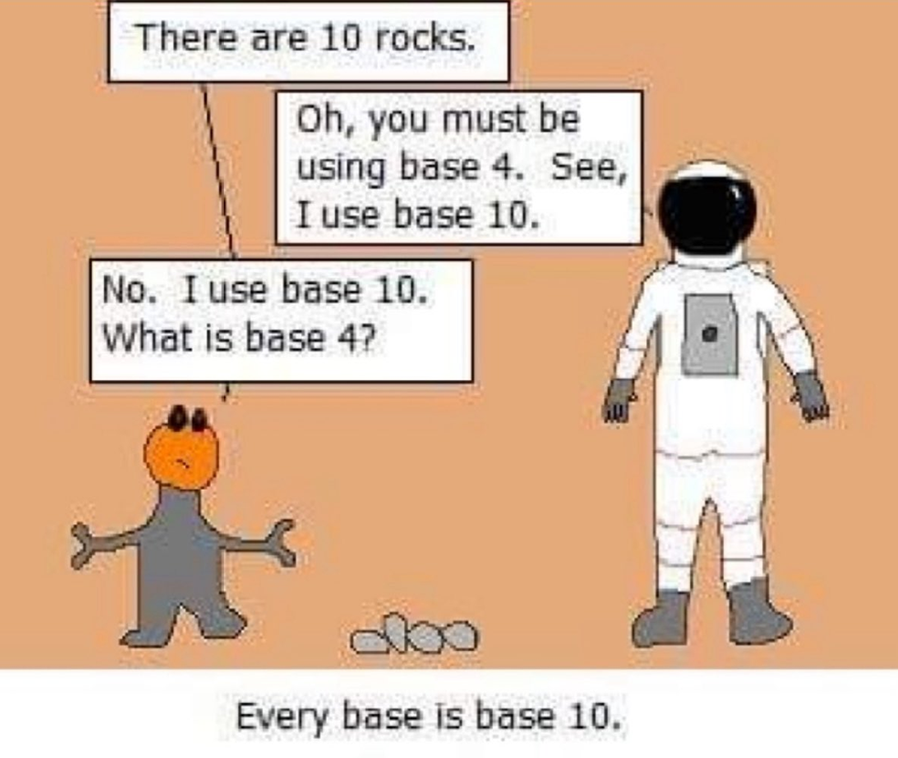

Slide 79
what made this possible
Digital circuits built with working parts in a correctly designed circuit will always give the right output, even if there’s some noise on the input.
Positional numbers
Digital circuits
Microelectronics

Slide 80
the noise margin
Manufacturers guarantee that a working part will have a minimum output voltage of 2.4V for a 1 and a maximum output voltage of 0.4V for a 0.
The part is forbidden to have an output voltage in the forbidden range in a properly designed circuit except when transitioning between states.
Output
Input
VCC = 5 V
High
High
V_{OH} = 2.4 V
V_{IH} = 2 V
Forbidden
Forbidden
V_{IL} = 0.8 V
V_{OL} = 0.4 V
Low
Low
TTL voltage levels

Slide 81
what made this possible
Engineers have known how to build digital circuits since the 1940s, but they only had tubes to work with.
Early computers, like the ENIAC, built in 1945, required 18,000 vacuum tubes and consumed 150KW. A tube failed every 2 days.
Positional numbers
Digital circuits
Microelectronics

Slide 82
what made this possible
Microelectronics made error-free digital circuits practical.
If we’d been stuck with tubes, the digital transformation of the modern world would not have happened.
Positional numbers
Digital circuits
Microelectronics

Slide 83
what made this possible
We can now throw billions of digital circuits at a problem.
You can have as many as you like, they take almost no space, and you can power them with a small battery.
Positional numbers
Digital circuits
Microelectronics

Slide 84
what made this possible
Transistor invented 1947 by John Bardeen, Walter Brattain and William Shockley at Bell Labs.
Positional numbers
Digital circuits
Microelectronics

Slide 85
what made this possible
Integrated circuit invented by Jack Kirby at Texas Instruments on September 12, 1958.
Positional numbers
Digital circuits
Microelectronics

Slide 86
what made this possible
Moore’s Law, 1965: The number of transistors in an integrated circuit doubles about every two years
Positional numbers
Digital circuits
Microelectronics

Slide 87
agenda
Course staff
Course organization
Learning objectives
System design
The project
Basic parts of a search engine
Planning your engine
Teamwork
The world around us
Beautiful software
Problem solving

Slide 88
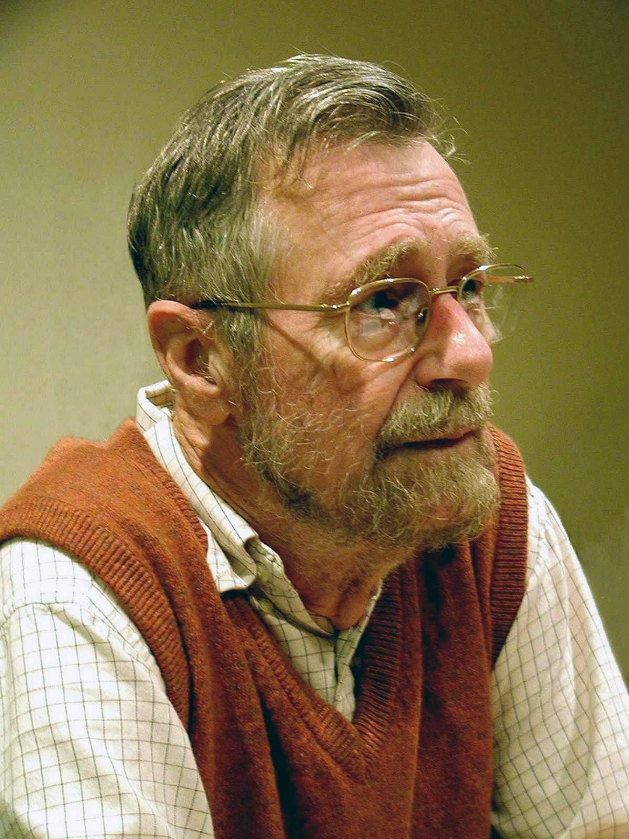
Who is this?

Slide 89
Edsger Dijkstra
(1930 – 2002)
Dutch computer scientist, coined “structured programming”, known for his work on mutual exclusion, winner of the first ACM Turing Award in 1972.

Slide 90

Edsger Dijkstra
Big believer in the importance of simplicity and highly critical of baroque programming languages with lots of features, especially PL/I, the C++ of the day.

Slide 91
Edsger Dijkstra
“I absolutely fail to see how we can keep our growing programs firmly within our intellectual grip when by its sheer baroqueness the programming language – our basic tool, mind you! – already escapes our intellectual control.”
“The Humble Programmer”, CACM, October 1972.

Slide 92
why I’m not a fan of STL
Algorithmic and tuning choices, performance and size tradeoffs and other issues are much harder to spot when hidden inside an opaque template, especially where the whole point of the template is that you’re not supposed to care how it works inside.

Slide 93
How big is an STL string?

Slide 94
How big is an STL string?
It depends on the compiler and OS.
With the MS compiler, an empty string takes 36 bytes = 28 bytes on the stack + 8 bytes on the heap. New'ing a string, it's the same two chunks but both go on the heap. Adding "hello" does not require additional memory. Adding another 28 characters requires another 48 bytes.
With Cygwin g++, an empty string takes 8 bytes whether it's on the heap or the stack. But the moment you add "hello" to it, it jumps to 38 bytes. Adding another 28 characters requires another 58 bytes allocated and 30 freed.
With g++ under WSL, an empty string takes 32 bytes whether it's on the heap or the stack. Adding "hello" does not require additional memory. Adding another 28 characters requires another 34 bytes.

Slide 95
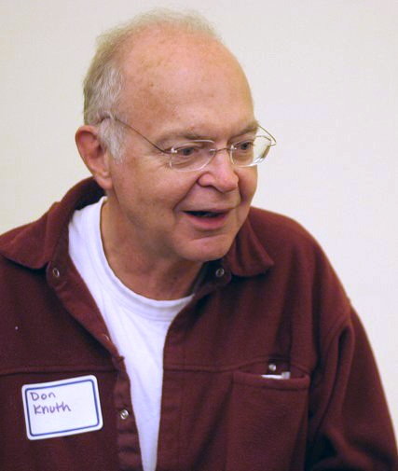
Who is this?

Slide 96
Don Knuth
Professor Emeritus at Stanford
Famous for his Art of Computer Programming textbooks. (Seven planned, only 3 written.)
He was my professor 46 years ago for CS 144A and B, introduction to algorithms and data structures.
Image source: https://en.wikipedia.org/wiki/File:KnuthAtOpenContentAlliance.jpg

Slide 97
Don Knuth on programming as art
“When I speak about computer programming as an art, I am thinking primarily of it as an art form, in an aesthetic sense. The chief goal of my work as educator and author is to help people learn how to write beautiful programs.”
-- Don Knuth, CACM, December 1974
Source: http://www.paulgraham.com/knuth.html

Slide 98
“My feeling is that when we prepare a program, it can be like composing poetry or music; … programming can give us both intellectual and emotional satisfaction, because it is a real achievement to master complexity and to establish a system of consistent rules.”

Slide 99
So, what is beautiful code?

Slide 100
beautiful code
“I may not know art but I know what I like.”
“If they can’t tell me how they would improve it if they could do it over, I won’t hire them.”
“Artists are never done with a piece, they just stop working on it.”

Slide 101
beautiful code
To me, beautiful code should be:
Elegant, easy to read, sparse, clear.
Stylish.
Fast and efficient.
It should make a hard problem seem easy.
To get better, you must be able to criticize your work.

Slide 102
beautiful code
Consider the problem:
Write a function that determines if a C-string contains doubled letters.

Slide 103
Here is one sample solution.
bool has_doubled_letters(const char *str) {
const char *ptr = str + 1;
while (*str != '\0' && *ptr != '\0') {
if (*str == *ptr) {
return true;
}
++str, ++ptr;
}
return false;
}

Slide 104
Here is another.
bool HasDoubledLetters( const char *s )
{
while ( *s && s[ 0 ] != s[ 1 ] )
s++;
return *s;
}

Slide 105
Can we say if we like one better than another?
bool has_doubled_letters(const char *str) {
const char *ptr = str + 1;
while (*str != '\0' && *ptr != '\0') {
if (*str == *ptr) {
return true;
}
++str, ++ptr;
}
return false;
}
bool HasDoubledLetters( const char *s )
{
while ( *s && s[ 0 ] != s[ 1 ] )
s++;
return *s;
}

Slide 106
agenda
Course staff
Course organization
Learning objectives
System design
The project
Basic parts of a search engine
Planning your engine
Teamwork
The world around us
Beautiful software
Problem solving

Slide 107
A lot of problem-solving is coming up with ideas of how to do something.

Slide 108
A lot of problem-solving is coming up with ideas of how to do something.
For example, a lot of debugging is coming up with ideas of how you got it wrong and how you’ll find your mistake.

Slide 109
The number 1 problem many people make is stopping with their first idea.
They refuse to ask what’s wrong with it and how it could be made better or if a different idea would be even better.

Slide 110
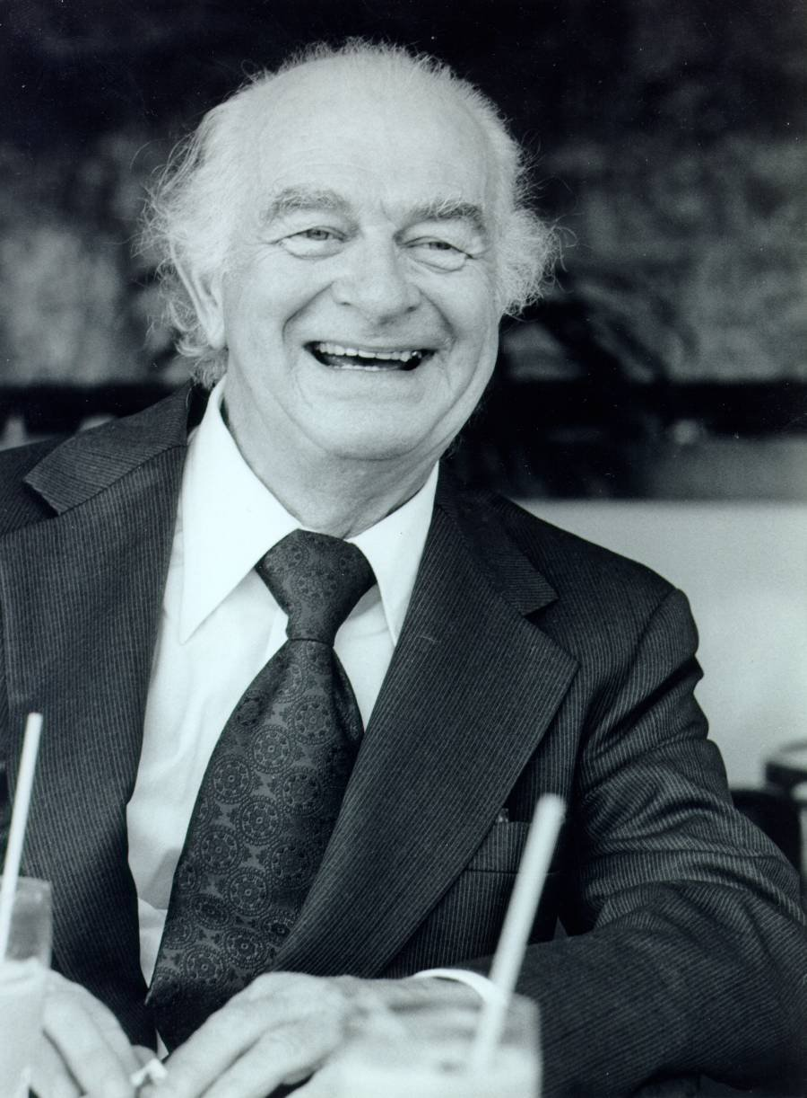
Who is this?

Slide 111
Linus Pauling (1901-1994)
American chemist, biochemist, peace activist.
Nobel Prizes in Chemistry and Peace.
Image source: http://www.villages-news.com/linus-pauling-and-prostate-cancer/

Slide 112
He was asked, “How do you get so many good ideas?”

Slide 113
“If you want to have good ideas you must have many ideas. Most of them will be wrong, and what you have to learn is which ones to throw away.”
-- Linus Pauling
As quoted by Francis Crick in his presentation, “The Impact of Linus Pauling on Molecular Biology” (1995).

Slide 114
Do you think people will steal your new idea?

Slide 115
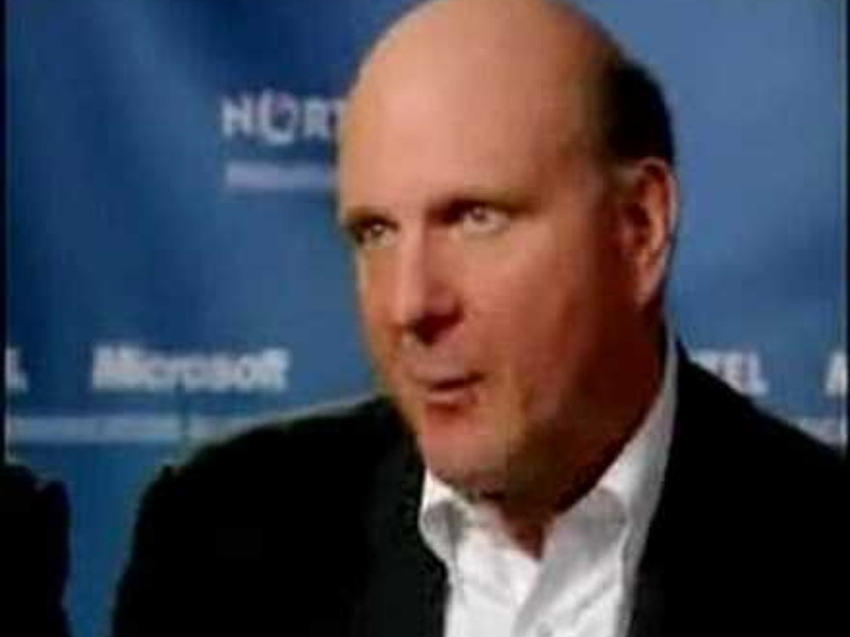
https://www.youtube.com/watch?v=eywi0h_Y5_U

Slide 116
new ideas
If an idea is really new, it’s surprisingly hard to give it away.
If it’s really good, most people will think you’re crazy.
Most people have trouble imagining how their life would be different and why they would want that.

Slide 117
Problem-solving versus problem-choosing

Slide 118
A fabulous solution to a problem nobody cares about is still a solution nobody cares about.
But even a mediocre solution to a really important problem can be important.

Slide 119
Opportunities are created when the world changes.
Something becomes possible that wasn’t before.

Slide 120
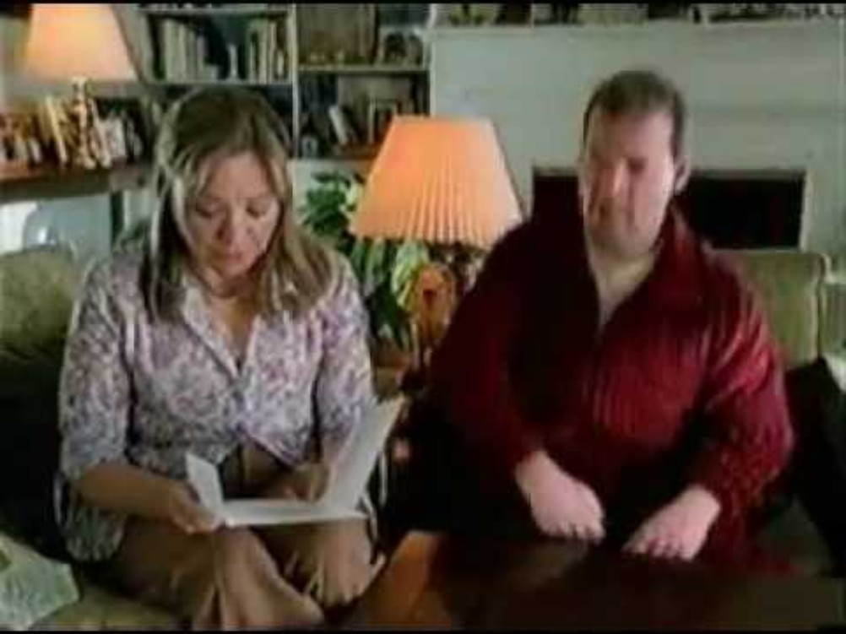
https://www.youtube.com/watch?v=_uXtWIg_A7M

Slide 121
what made search engines possible
The insight was that you could do it.
You could crawl the entire web and make and index your own private copy of the whole thing.
Processors, bandwidth and storage were so cheap you could do it.
When MSN Search went live in Jan 2005, we had 10 rows of 500 machines, each with a copy of 1/500-th of the entire web = 10 complete copies.

